Slide 1
Covid-19 Analysis
By-TAMIZHARASI
SHRAVAN PANDAY,
KEDAR DESAI,
NISHANT SHUKLA

Slide 2
A brief about our project
We tried to generate insights into the effect of Covid-19 on our country and tried to visualize how it varied over months and weeks in different states and its overall impact on general public life.
Detailed visualization of the number of confirmed cases, recovered cases, deaths, and tests are shown in this presentation.
We categorized different districts into 5 categories by generating a KPI called testing ratio which gives us the percentage of the population tested to the total population and tried to segregate the Covid -19 impact for enhanced understanding.

Slide 3
Insights from the analysis
It’s evident from the data that in the states in which the vaccination drive was better, the death rate in that state was less compared to other states.
The Maximum number of deaths occurred in Category B cities.
Least vaccination was done in category B Cities.
Maximum vaccination was done in a state with state code ‘TT’.
Covid-19 was at its peak in the month of October in India registering the maximum number of confirmed cases.

Slide 4
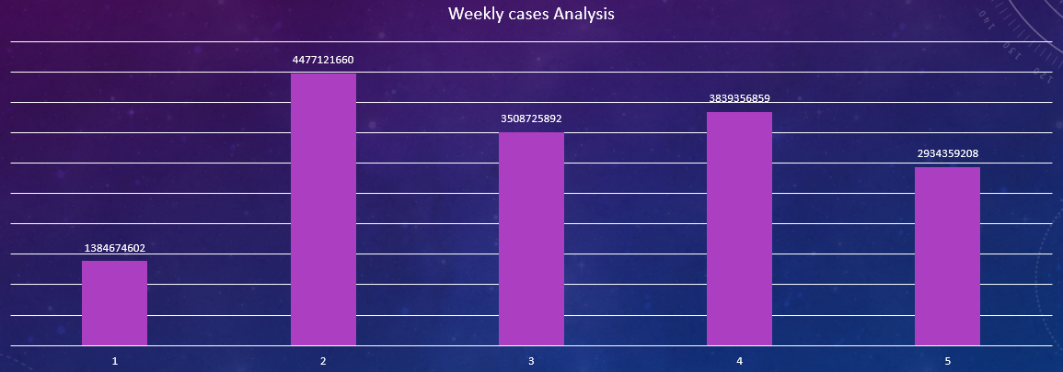
Weekly distribution of confirmed cases in all months

Slide 5
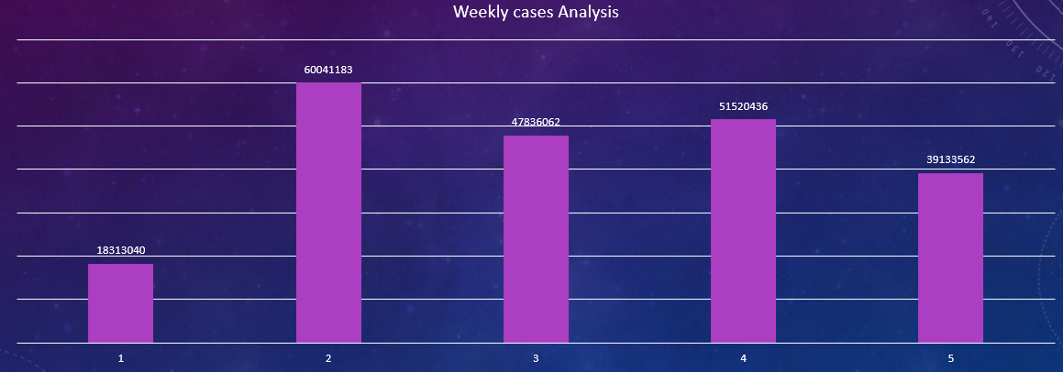
Weekly distribution of deceased cases in all months

Slide 6
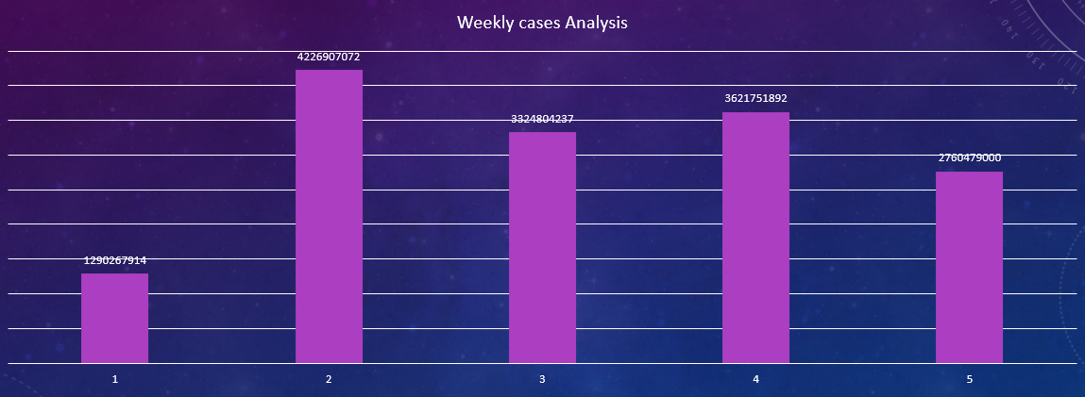
Weekly distribution of recovered cases in all months

Slide 7
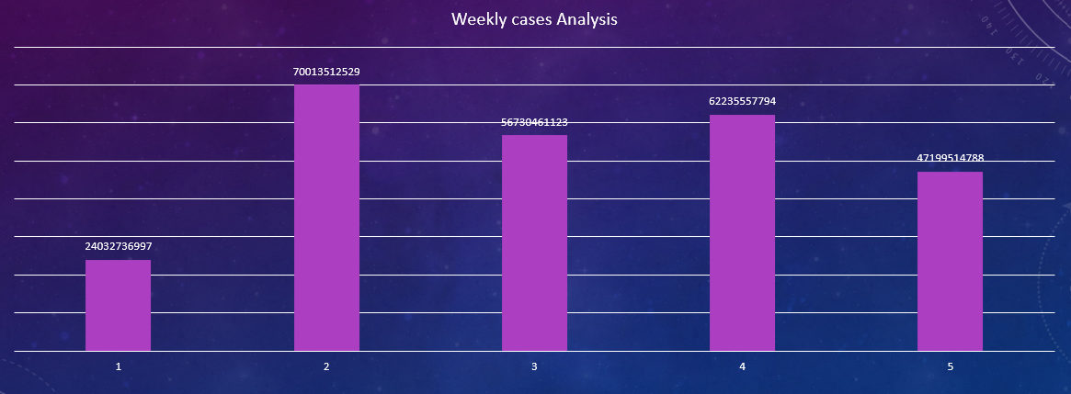
Weekly distribution of tested cases in all months

Slide 8
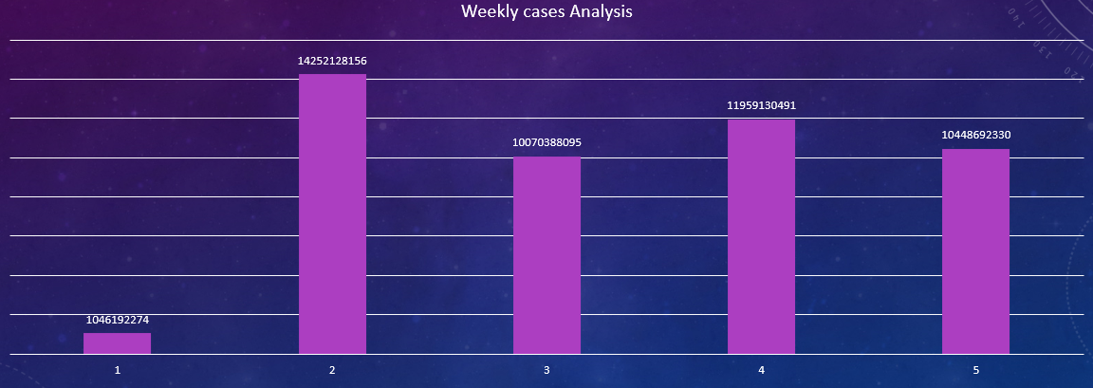
Weekly distribution of Vaccinated cases in all months

Slide 9
Category wise distribution
Here we tried to categorize the data by dividing the tested population into the total population to better understand how Covid-19 affected different districts in different parts of the country.

Slide 10
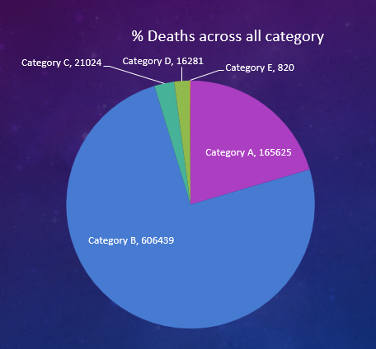
Overall distribution of how deadly the covid-19 has been in various categories

Slide 11
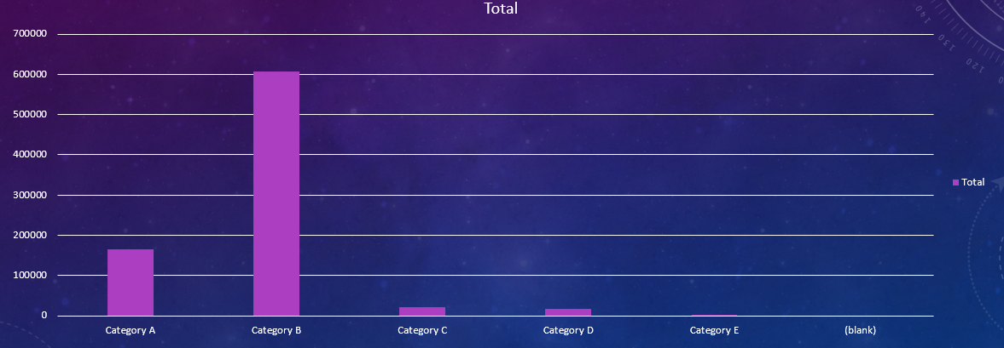
Depiction of total deaths in different categories

Slide 12
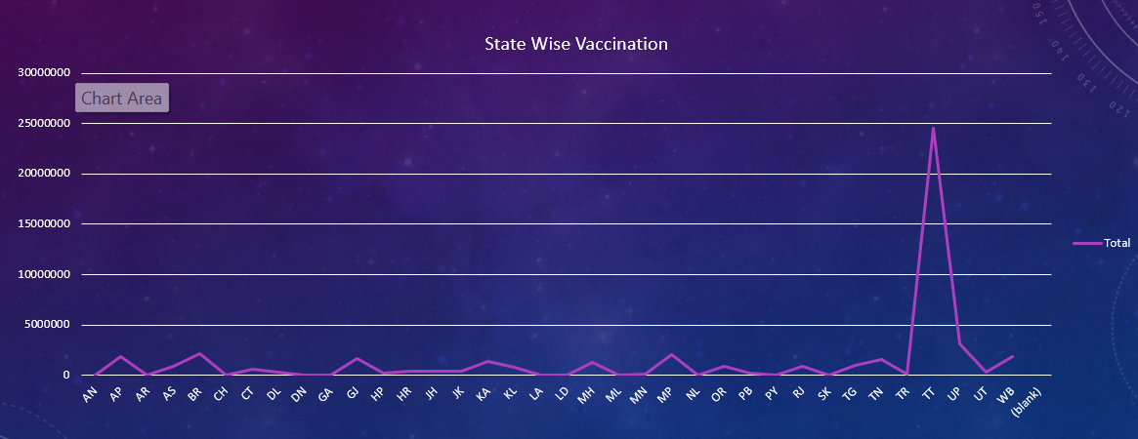
State-wise Vaccination Distribution

Slide 13
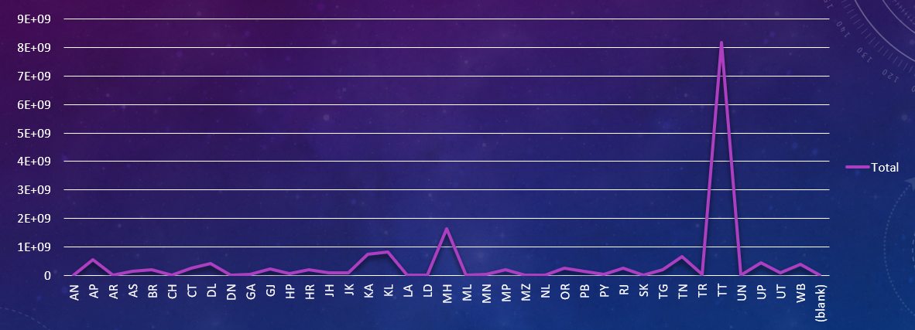
State-wise distribution of confirmed cases

Slide 14
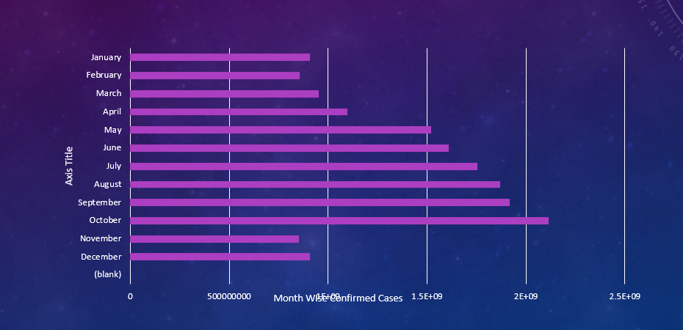
Month-wise distribution of confirmed cases Most confirmed cases were found in oct month

Slide 15
Thank You

